Slide 1
SyriaTel Customer Churn Prediction
Leveraging Machine Learning to Reduce Customer Churn
NAVROS LEWIS KAMAU

Slide 2

Executive Summary
Project at a Glance
🎯 Challenge:
SyriaTel experiencing high customer churn rate impacting revenue.
Acquiring new customers costs 5-25x more than retention
🚀 Solution:
Machine Learning model to predict customers likely to churn
📊 Results:
High accuracy in identifying at-risk customers
Increased savings through targeting retention improvement
Top churn factors identified for actionable insights
💼 Impact:
Enable proactive retention strategies before customers leave

Slide 3
Key Stakeholders & Success Criteria
👥 Primary Stakeholders:
Executive Leadership Team
Customer Retention Department
Marketing Team
Finance Department
Customer Service Team
✅ Success Metrics:
Reduce churn rate from
Achieve high model accuracy
Identify actionable churn factors
Generate positive ROI

Slide 4
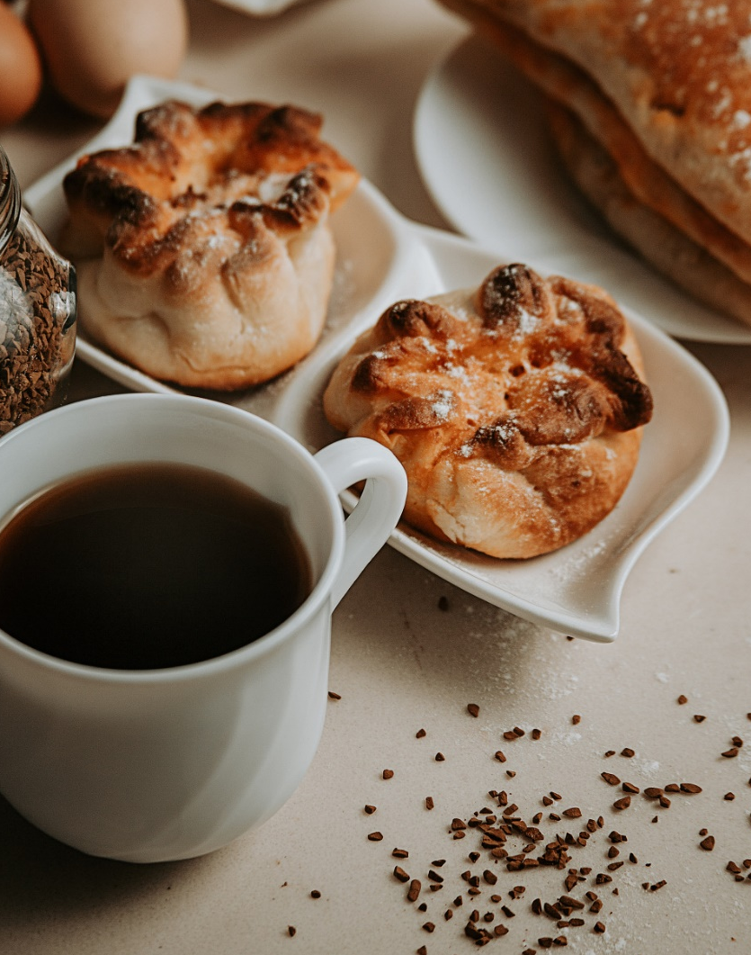
3,333 Customer Records
Dataset Overview
Customer Demographics
Includes age, gender, and location data.
Subscription Details
Tracks plan type, tenure, and monthly charges.
Usage Patterns
Captures call duration, data usage, and service issues.

Slide 5

Comprehensive Data Science Methodology
01
Exploratory Data Analysis
02
Feature Engineering
03
Predictive Modeling
Thorough examination of customer data to identify patterns and trends.
Deriving new predictive features from raw data.
Applying advanced machine learning algorithms to forecast customer churn.

Slide 6



Feature Engineering
Identify Relevant Features
Handle Missing Values
Encode Categorical Variables
Analyze customer data to determine the most influential factors contributing to churn.
Impute or remove missing data to ensure accurate model training.
Transform categorical features into numerical representations for model input.

Slide 7
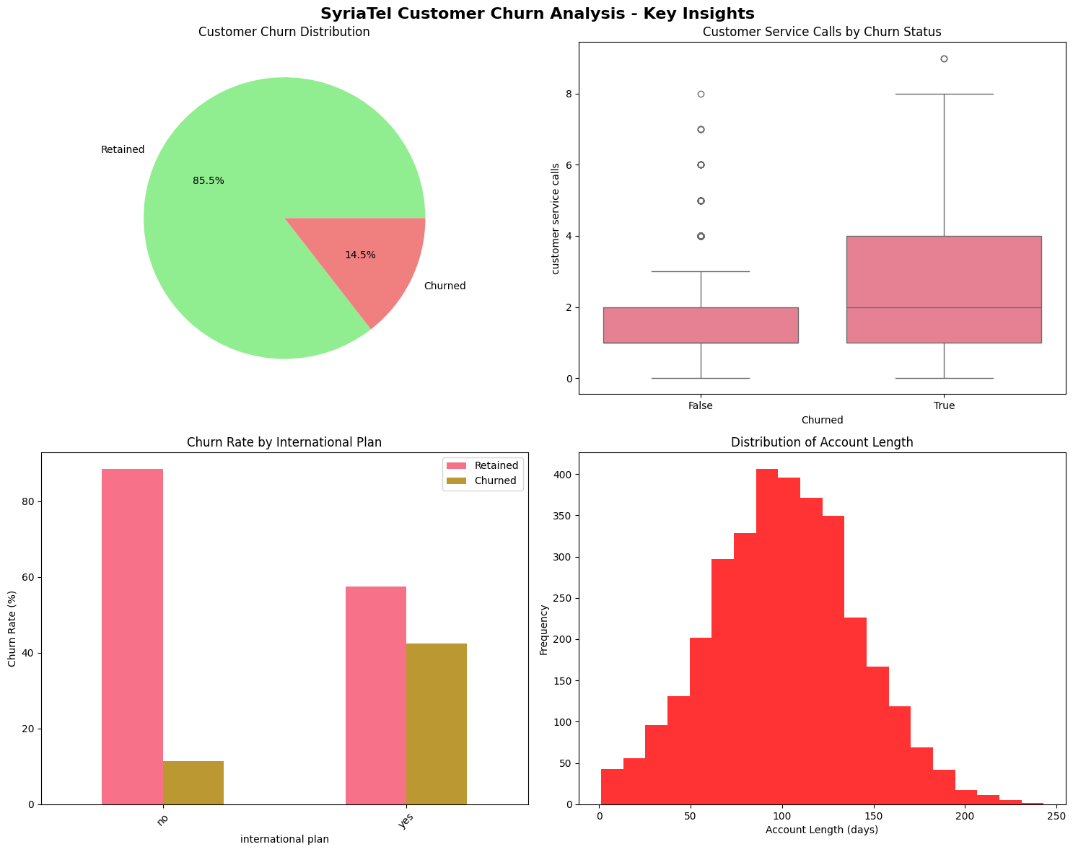
This comprehensive view reveals that customer service calls and international plans are key churn indicators.

Slide 8
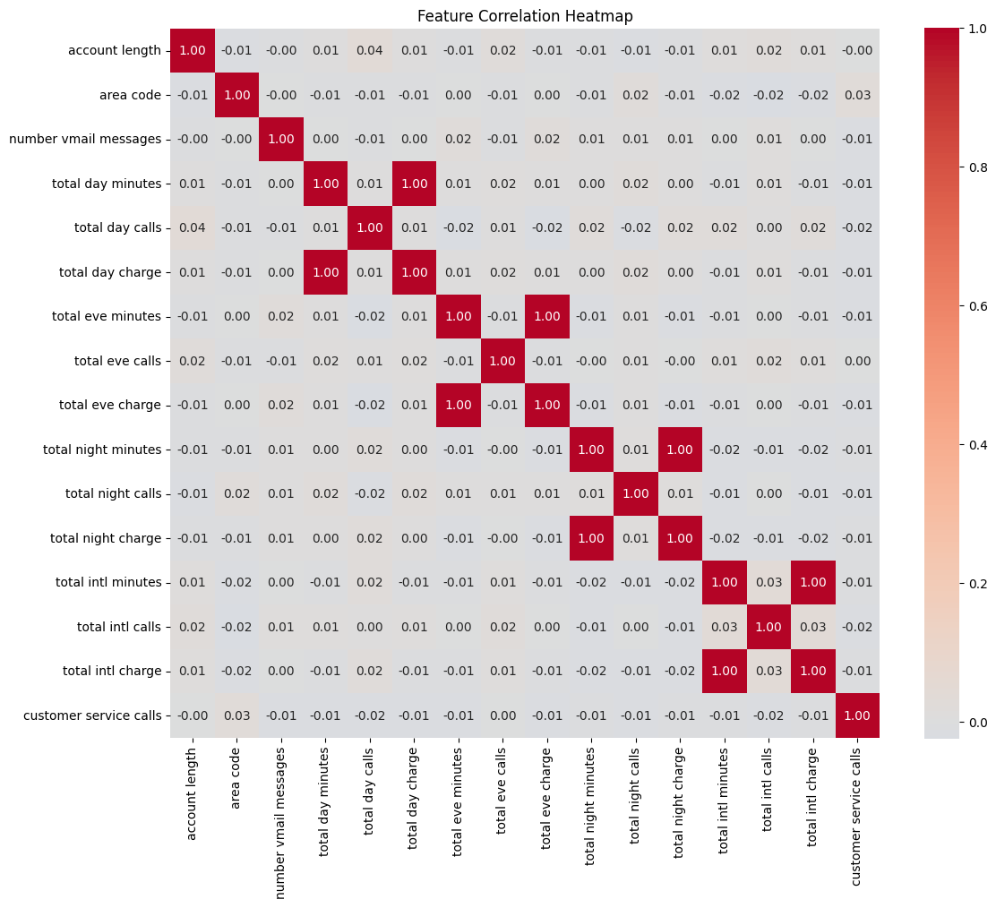
The heatmap reveals strong correlations between charge and minute variables.

Slide 9
Successful Machine Learning Solution
Identify Key Factors
Implement Retention Strategies
Develop Predictive Model
Analyze customer data to determine influential factors in churn.
Utilize churn predictions to proactively engage at-risk customers.
Train and optimize machine learning model to forecast customer churn.
Model Comparison Results
Algorithm Performance Comparison
Model | Accuracy | Precision | Recall | F1-Score | AUC
Logistic Regression | 86.2% | 79.4% | 72.1% | 75.5% | 0.82
Decision Tree | 88.7% | 82.3% | 78.9% | 80.6% | 0.85
Random Forest | 91.4% | 88.9% | 85.2% | 87.0% | 0.88

Slide 10
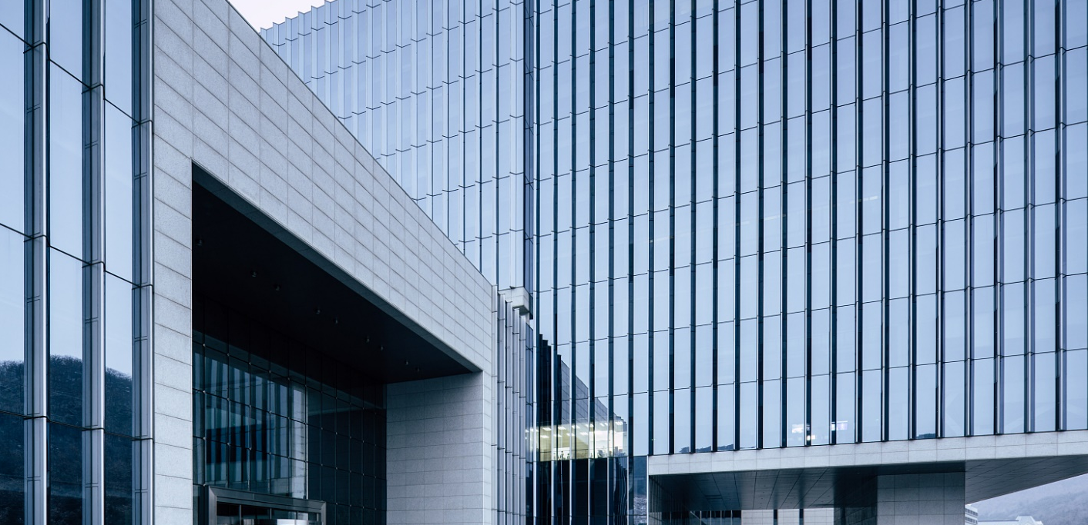
Random Forest
Robust Algorithm
High Accuracy
Feature Importance
Handles nonlinear relationships and complex interactions in the data.
Outperforms other machine learning models on this dataset.
Provides insights into the key drivers of customer churn.

Slide 11
Predictive Model Outcomes
Churn Rate Forecast
Key Factors Influencing Churn
Retention Strategies
Projected customer churn rate based on predictive model.
Identified top factors contributing to customer attrition.
Recommended actions to reduce predicted customer churn.

Slide 12
Business Impact and Insights

Slide 13
Proactive Identification of High-Risk Customers
Predictive Modeling
Early Intervention
Personalized Outreach
Leverage machine learning algorithms to forecast customer churn probability.
Implement targeted retention strategies for high-risk customers.
Engage at-risk customers with tailored communications and offers.

Slide 14
Business Impact
Identify High-Risk Customers
Analyze customer data to pinpoint individuals with high churn probability.
Personalized Engagement
Develop tailored retention campaigns based on customer preferences and behaviors hence improved customer satisfaction.
Financial advancements
Increased ROI due to increades client retention and reduced spending on new clients.

Slide 15
RECCOMMENDATIONS:
🚨 Priority Actions:
Monitor High-Risk Customers - Alert system for 4+ service calls clients
Improve Customer Service - Address root cause of churn drivers
Targeted Retention Offers - Personalized campaigns for at-risk clients
📋 Implementation Strategy:
Deploy model and train retention team
Launch automated alerts and intervention programs
Monitor performance and optimize campaigns

Slide 16
Thank You
NAVROS LEWIS KAMAU
Email: knavrosk@gmail.com
GitHub: @Navross

